Slide 1
CPU Scheduling Module 1 Introduction
David Liu
Fall 2021, Spring 2022

Slide 2
Learning Objectives
Understand importance of CPU scheduling
Describe various CPU scheduling algorithms

Slide 3
Process or Thread, CPU or Core
Modern OS schedules kernel-level threads
Core is the basic computation unit
OS schedules a kernel-level thread in a core.

Slide 4
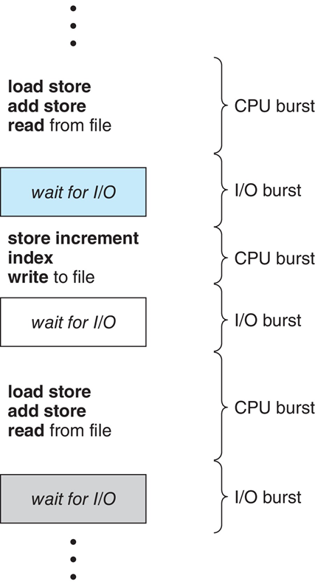
Multiple threads concurrently in One Core
Maximum CPU utilization obtained with multiprogramming
CPU–I/O Burst Cycle –
Process execution consists of a cycle of CPU execution and I/O wait
CPU burst followed by I/O burst
CPU burst distribution is of main concern or opportunity

Slide 5
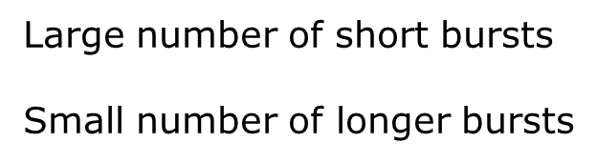
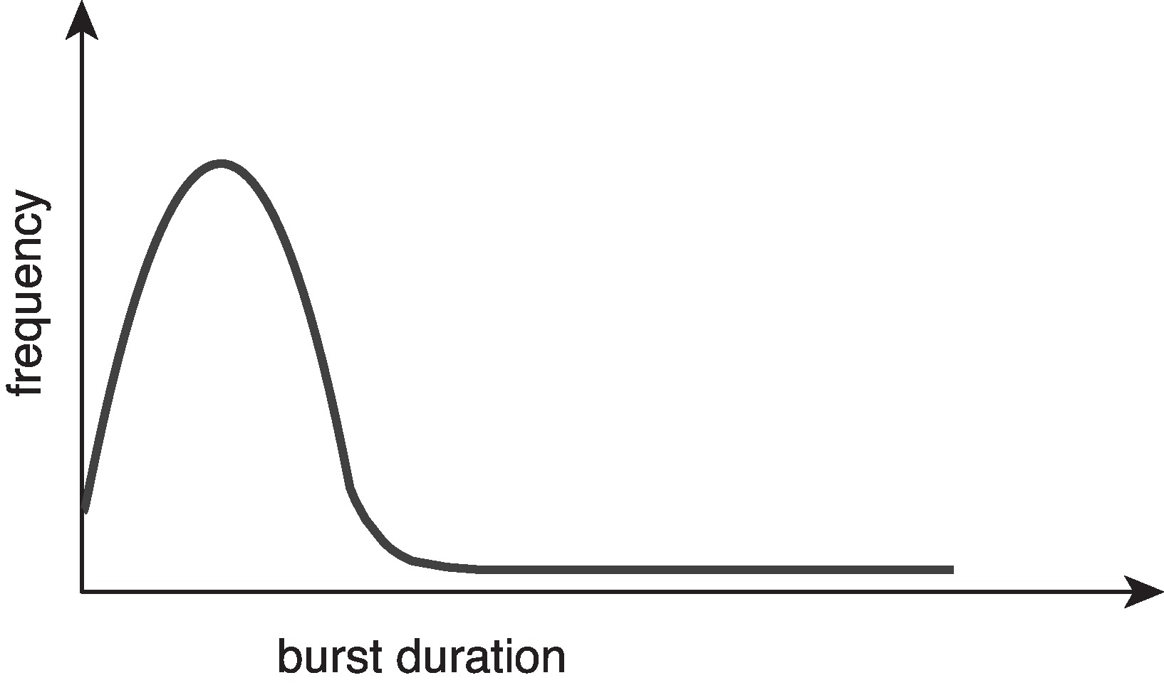
CPU-burst Times

Slide 6
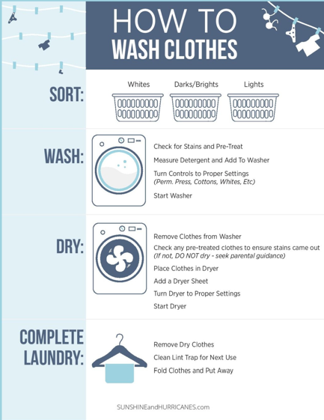
Laundry

Slide 7




Laundry Resources

Slide 8
OS Scheduler
Short term
CPU scheduler
Selects from a processes from ready queue
Allocates a CPU core
Intermediate
Swapping
Remove a process from memory
Reduce the degree of multiprogramming
long term
Job scheduler
Bring a job to the memory and ready queue

Slide 9

When Scheduling Happens
2. Preemptive, OS removes this interrupted process from CPU
4. Nonpreemptive, volunteering
3. Preemptive, OS may remove another process from CPU
1. Nonpreemptive, volunteering

Slide 10
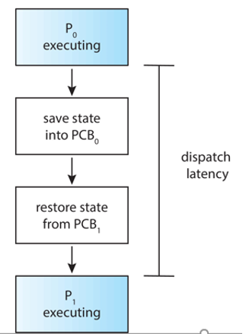
CPU Dispatcher
Steps
Switch context from one process to another
Switching to user mode
Jumping to the proper location in the user program
Dispatch Latency

Slide 11
Scheduling Criteria
CPU utilization
Throughput: # of completed processes/sec
Turnaround time: a process from start to finish
Waiting time: amount of time a process has been waiting in the ready queue (adds up)
Response time: from a request to the first response

